Slide 1
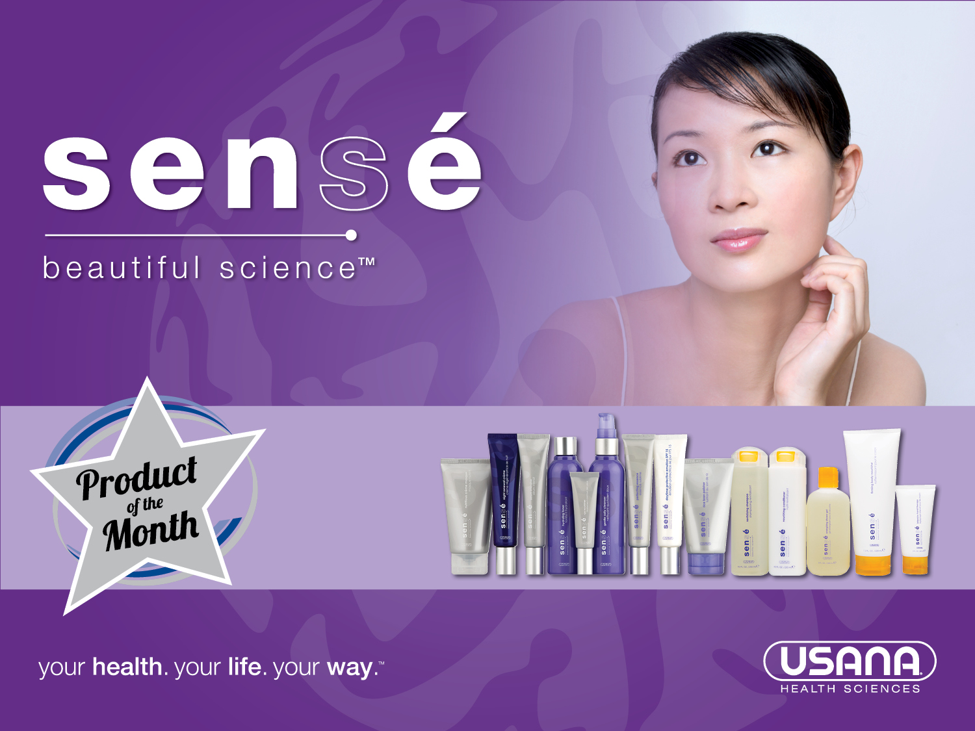

Slide 2


Under attack!
Whatever your age
or stage, sex or
season, sunshine,
stress and pollution
can play havoc with
your skin.

Slide 3
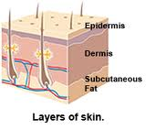
About your skin
Skin reflects inner and outer body health.
Your body’s largest organ.
In constant contact with the outside world.
Absorbs substances applied to it and that it comes into contact with – including preservatives.

Slide 4

Look, no parabens!
USANA’s Sensé range doesn’t use harsh chemicals or preservatives. It uses a patented self-preserving technology to keep products fresh and potent.
Notes:
The preservative problem and parabens
Preservatives help to prevent microorganisms including bacteria and moulds from multiplying in a product and causing spoilage.
Parabens are one common group of chemical preservatives used widely in foods as well as in cosmetics and skincare; they are relatively cheap to use. If you are prone to sensitivity or irritation from cosmetics and toiletries, you may be reacting to parabens in the product. So, it’s best to avoid those and also other items which can trigger flare ups. Because your body is exposed to chemicals every day – including via skincare products – and we don’t yet know what the long-term cumulative effects on health could be.

Slide 5
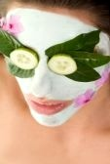
Self-Preserving Technology
Self-Preserving Technology (SPT) is an original blend of botanicals, antioxidants and active ingredients that keep every Sensé product fresh.
Notes:
Self-Preserving Technology
By investing a little more in research and formulations, USANA have been able to bin chemical preservatives. The gentle formulations help promote a calm, healthy complexion.

Slide 6

SPT action
The SPT is carried in liquid
Crystals. It delivers purifying botanicals and antioxidants to nourish the skin – in pockets where its most needed.
SPT provides food for skin
Notes:
One way is the use of patented Self-Preserving Technology (SPT). This original blend of botanicals, antioxidants and active ingredients keep every Sensé product fresh. This ensures that harsh chemicals including parabens and formaldehyde-producing chemicals aren’t needed.
The SPT is carried in liquid crystals to deliver purifying botanicals and antioxidants to nourish the skin. Every aspect of product and production is carefully controlled – from water availability, to pH control, use of ingredients, manufacturing and packaging to prevent contamination with microorganisms at every step of production.

Slide 7
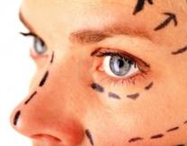
About skin ageing
Part of the skin ageing
process occurs when
natural enzymes break
down the skin proteins
that keep it looking youthful. These enzymes
are more active with age.
Sensé contains DSR™ combats signs of ageing.
Notes:
Enzymes naturally breakdown the skin and are a natural part of ageing.
Dermal Surface Renewal (DSR™) is USANA's exclusive anti-ageing complex. In two effective ways, DSR supports the reduction of the appearance of existing signs of ageing and helps prevent the appearance of new lines and wrinkles.

Slide 8

Dermal Surface Renewal Technology
Evens skin tone, refines, brightens and firms skin.
Increases cell turnover rate
slowing ageing enzymes.
Find DSR in Perfecting
Essence, Night Renewal,
Serum Intensive and Eye Nourisher.
Notes:
Dermal Surface Renewal Technology
DSR is a marine-source formulation that evens skin tone and retextures, refines, brightens, and firms the skin's surface.
Part of the skin ageing process occurs when natural enzymes break down the proteins that keep skin looking youthful. These enzymes become more active with age.
DSR is a scientific breakthrough that increases cell turnover rate reducing the activity of these ageing enzymes. Because it helps to maintain a firm and elastic intercellular-matrix, you can see the results right away. Skin looks rejuvenated, firmer and more elastic. DSR is found in Perfecting Essence, Night Renewal, Serum Intensive and Eye Nourisher.

Slide 9
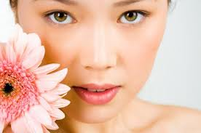
Regenisomes
Regenisomes supply enzymes
that assist in cell renewal in sun
damaged skin called Photosomes.
Find these fast-acting, light-
activated enzymes in Daytime Protective Emulsion.
Ultrasomes work more slowly to protect the skin without light; find them in Night Renewal and Eye Nourisher.

Slide 10

Proflavanol-T™
Natural moisture-protect
Complex, rich in flavonoids from
grapes, green tea, vitamin E for
healthy looking skin.
Natural antioxidants help shield
and protect skin from daily
environmental effects.
Helps protect skin from free radical damage
Notes:
Proflavanol-T a complex of whole grape extract, green tea extract, rice-derived gamma oryzanol and vitamin E. This flavonoid rich complex helps to shield and protect skin from effects of the environment whilst providing natural moisture.
Research shows that grape seed extract contains unique potent antioxidants with many skin benefits. Plus two active forms of vitamin E which help protect cell membranes. Rice derived gamma oryzanol plus vitamin E make for a powerful antioxidant which soots and moisturises the skin.
Proflavanol-T the benefits
Natural moisture protect complex rich in flavonoids from whole grape, green tea, vitamin E and rice-derived oryzanol as a first line of defence for healthy looking skin
Helps shield and protect skin from daily effects of the environment
Helps protect skin from free radical damage

Slide 11
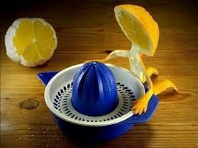
Vitamin C as Proteo-C ™
Proteo-C™ vitamin C complex
(exclusive to Sensé), contains
two bioavailable forms of
vitamin C.
Firms and helps reduce uneven
skin tones.
Improves skins radiance, clarity
and texture.
Shields and protects skin from daily environmental damage.
Notes:
Proteo-C™ vitamin C complex (exclusive to Sensé), contains two bioavailable forms of vitamin C - magnesium ascorbyl phosphate which combines with the amino acid proline and glycine. These make for a revolutionary water- and lipid-soluble complex. So that vitamin C is delivered to the dermal layers of the skin. With powerful skin-protecting and firming qualities, this complex helps to reduce the appearance of skin ageing, helps neutralise free radicals and improve skin radiance and texture.
The amino acids proline and glycine are highly effective moisture magnets. They act as essential elements in collagen and elastin products. These structural proteins give strength and elasticity to the skin and help reduce appearance of fine lines.
Proteo C – the benefits
Firms, brightens and helps reduce uneven skin tones
Improves skins radiance, clarity and texture
Shields and protects skin from daily environmental damage

Slide 12

Daily skincare
Gentle Daily Cleanser
Rice Bran Polisher
Nutritious Crème Masque
Hydrating Toner
Perfecting Essence
Daytime Protective Emulsion SPF15
Serum Intensive (for mature skin)
Night Renewal every night.
Eye Nourisher
Notes:
Sensé great for women and men of all ages and all skin types
Cleanse with Gentle Daily Cleanser (Twice a Day) its soap free, non-drying, and contains natural botanicals that soften the skin and lock in moisture.
Exfoliate with Rice Bran Polisher (Three times a week – AM or PM)
Deep Cleanse with Nutritious Crème Masque (Three times a week – AM or PM)
Tone with Hydrating Toner twice daily. is used as a clarifier to refine pore size. It also delivers the active ingredients to the skin. At this low concentration, people with oily skin and dry skin can use these products..
Apply Perfecting Essence (for younger skin) while the skin is damp and then apply Daytime Protective Emulsion SPF15 with sunscreen to avoid sun damage and slow down UV rays that cause wrinkles.
Apply Serum Intensive (for mature skin)/ twice daily to fight wrinkles and reduce the appearance of ageing before applying your Night Renewal every night.
Moisturise at night with Night Renewal.
Apply Eye Nourisher twice daily. The moisturisers plump up the skin a little, evening it out and helping makeup to glide on.
USANA’s Sensé contain pure and clean ingredients, so they’re gentle and healthy for your skin and your body. In fact, they’re as gentle and as pure as it gets!

Slide 13

Men - keep it clean!
Men’s oilier skin and larger
pores trap dirt more easily.
Try non-drying Gentle Daily
Cleanser to gently cleanse and
hydrate.
Notes:
Men – your approach to complexion perfection!
Spurred on by well-groomed superstars like Hugh Jackman and David Beckham, skincare for men is mainstream. And despite a few differences in men’s skin and women’s skin (women naturally have more fat under the surface); skin care needs for men and for women is essentially the same. Build these skin-care routines into your day to look younger for longer.
Keep it clean. Men’s skin is around 15 per cent oilier than women’s and the much larger pores mean that you’re more prone to trapping dirt. So, wash your face and neck every day. Gentle Daily Cleanser is soap free and non-drying.
Try a gentle exfoliation – this helps to remove the top layer of skin and unblocks pores helping to reduce the occurrence of spots and ingrown hairs. Apply a warm facecloth to your skin to open up the pores. Then exfoliate with Rice Bran Polisher. Try it twice a week after your morning wash for smoother skin and to help soften stubble for a closer shave.
Then, apply moisturiser. But it’s important to apply enough to get a positive effect. So, with long strokes from the inside of your face out, apply Daytime Protective Emulsion SPF15. Gently apply some extra moisturiser under your eyes – after all, your eyes are just as likely to crease as a woman’s!
And at night-time, after cleansing, don’t forget to apply Night Renewal (over some Serum Intensive if fresh, youthful skin is what you’re after.

Slide 14
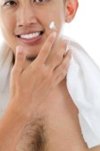
Exfoliate!
Exfoliation unblocks pores helping
Reduce the occurrence of spots and
ingrown hairs.
Don’t skimp on the moisturiser.
Apply Daytime Protective Emulsion
SPF15.
At night, after cleansing, apply
Night Renewal (over some Serum Intensive.
Notes:
Men – your approach to complexion perfection!
Spurred on by well-groomed superstars like Hugh Jackman and David Beckham, skincare for men is mainstream. And despite a few differences in men’s skin and women’s skin (women naturally have more fat under the surface); skin care needs for men and for women is essentially the same. Build these skin-care routines into your day to look younger for longer.
Keep it clean. Men’s skin is around 15 per cent oilier than women’s and the much larger pores mean that you’re more prone to trapping dirt. So, wash your face and neck every day. Gentle Daily Cleanser is soap free and non-drying.
Try a gentle exfoliation – this helps to remove the top layer of skin and unblocks pores helping to reduce the occurrence of spots and ingrown hairs. Apply a warm facecloth to your skin to open up the pores. Then exfoliate with Rice Bran Polisher. Try it twice a week after your morning wash for smoother skin and to help soften stubble for a closer shave.
Then, apply moisturiser. But it’s important to apply enough to get a positive effect. So, with long strokes from the inside of your face out, apply Daytime Protective Emulsion SPF15. Gently apply some extra moisturiser under your eyes – after all, your eyes are just as likely to crease as a woman’s!
And at night-time, after cleansing, don’t forget to apply Night Renewal (over some Serum Intensive if fresh, youthful skin is what you’re after.

Slide 15

Great skin from within
Veggie and fruits contain plant
antioxidants and vitamin C to
help strengthen/produce
collagen fibres helping skin stay
firm.
Vitamin C also helps to mop up free radicals which can damage body cells including skin cells. Find vitamin C in Essentials™, HealthPak™, BodyRox™ (for teenagers) and Proflavanol® C™ and Poly C™.
Notes:
While topical treatments are essential to protect and plump the skin, USANA nutritional supplements can also help boost skin health and appearance.
Defend your skin against the free radical damage with a diet that’s rich in antioxidant vitamins and minerals. Vegetables and fruits contain plant antioxidants and vitamin C to help strengthen and produce collagen fibres, the structure that holds your skin together and helps skin stay firm. Vitamin C also helps to mop up free radicals which can damage body cells including skin cells. Find vitamin C in Essentials™, HealthPak™, BodyRox™ (for teenagers) and Proflavanol® C™ and Poly C™.

Slide 16

Vitamin E
This fat-soluble vitamin
which is thought to work
alongside water-soluble
vitamin C.
The duo, guard against free radical attack by providing a potent boost of anti-ageing skin protection.
Notes:
Vitamin E
This fat-soluble vitamin which is thought to work alongside water-soluble vitamin C. The duo guard against free radical attack by providing a potent boost of anti-ageing skin protection. Enjoy E-containing foods like wheat germ, fortified cereals, nuts and seeds. You’ll also find vitamin E in HealthPak™, Essentials™ and E-Prime™.

Slide 17

Omega-3s
Getting enough omega-3s has
many health benefits – one is to help reduce water loss from the skin helping it to stay moisturised and plump.
BiOmega™ is a great source of pure, omega-3s.
Notes:
Omega-3s
Oily fish like salmon and fresh tuna contain omega-3 fats which the vast majority of us are very low on. Getting enough omega-3s has many health benefits – one of these is that they can help to reduce water loss from the skin helping it to stay moisturised and plump.
Other oily fish include fresh tuna but canned tuna and salmon also provide omega-3s as do white fish although in smaller concentrations. Oily fish is also important because it provides vitamin D which most of us are short of. And, considering that 90 per cent of our vitamin D intake comes from the action of sunlight on the skin and sunlight is scarce in the winter months and protected in the summer months, salmon really is a great choice! Aim to eat two servings of oily fish each week: not only are the omega-3s good for your skin, they're good for your heart too. BiOmega™ is a great source of pure, omega-3s.

Slide 18

Water – drink up!
Around 70 per cent of your body
is made from water
Water reaches your skin
only after reaching your
internal organs so hydrate
regularly.
Notes:
Water
When you drink water, it reaches your skin only after reaching your internal organs so it’s important to drink regularly. Keep your skin hydrated and plump by drinking plenty of water, green tea and herbal teas, and help keep you hydrated from the inside out.

Slide 19

Pure, gentle and healthy!
Sensé contains pure
and clean ingredients, so
they’re gentle and healthy
for your skin and your body.
In fact, they’re as gentle and
as pure as it gets!
The exclusive self-preserving technology that is currently used in all Sensé – beautiful science™ skin care products is protected under U.S. Patent No. 7,214,391. The Sensé and Sense – beautiful science trademarks are the property of USANA Health Sciences Inc.
Notes:
N.B. The exclusive self-preserving technology that is currently used in all Sensé – beautiful science™ skin care products is protected under U.S. Patent No. 7,214,391. The Sensé and Sense – beautiful science trademarks are the property of USANA Health Sciences Inc.

