Slide 2
GingkoPS™
Ginkgo’s medicinal heritage
dates back to around
2800 BC.
Leaves of the ginkgo tree
contain over 40 active
components
Notes:
With a medicinal heritage that dates back thousands of years (ginkgo’s medicinal use in China dates back to around 2800 BC), the ginkgo biloba tree species is so old that it’s considered to be a living fossil – a relic of the Ice Age in fact!
The leaves contain over 40 active components.
The two most therapeutic of these are called flavonoids and terpenoids.

Slide 3
Phosphatidylserine
Ginkgo PS contains
the lipid phosphatidylserine –
vital for the normal
functioning of all body cells
and abundant in the brain.
Notes:
USANA’s GingkoPS™ combines the benefits of ginkgo with phosphatidylserine (PS), a lipid (fat) that’s vital for the normal functioning of all body cells.
PS is abundant in the brain reflecting its involvement in nerve cell functions such as nerve transmission.

Slide 4
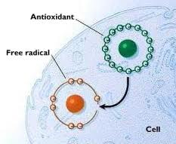
Ginkgo extract
Contains powerful free
radical-neutralising antioxidants.
Helps capture free radicals in the
brain, eyes, cardiovascular
system nerves and more.
Notes:
Ginkgo extract contains a mix of bioflavonoids, powerful antioxidants that help to neutralise free radicals which are destructive molecules that can damage cells and DNA (genetic material).
The antioxidants in ginkgo are thought to help capture free radicals in the brain, the eyes and also protect cells in the cardiovascular (heart and blood vessel system), nerves, and more. J Mol Cell Cardiol. 1997 Feb;29(2):733-42.
Cardioprotective and anti-oxidant effects of the terpenoid constituents of Ginkgo biloba extract (EGb 761).
Pietri S, Maurelli E, Drieu K, Culcasi M.
Source Unité Mixte de Recherche 6517 du Centre National de la Recherche Scientifique, Université d'Aix-Marseille I, Marseille, France. http://www.ncbi.nlm.nih.gov/pubmed/9140830

Slide 5
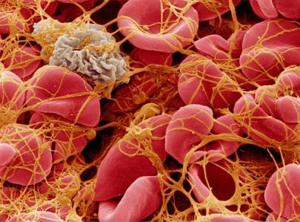
Terpenoids
Ginkgo contains terpenoids
which reduce the
stickiness of platelets,
constituents of blood that
encourage blood clotting.
Notes:
Ginkgo also contains terpenoids, substances which help to ‘thin’ the blood. They work by helping to reduce the stickiness of platelets, constituents of blood that encourage blood clotting. Pharmacopsychiatry. 1996 Jul;29(4):144-9.
Ginkgo biloba extract (EGb 761) independently improves changes in passive avoidance learning and brain membrane fluidity in the aging mouse. Stoll S, Scheuer K, Pohl O, Müller WE.
Source Central Institute for Mental Health, Section Psychopharmacology, Mannheim, Germany. http://www.ncbi.nlm.nih.gov/pubmed/8858713

Slide 6
Blood clotting is important
When blood is exposed to
air, platelets break apart to
plug the wound, helping
prevent major blood loss.

Slide 7
Stress and hypertension
Stress hormones make
blood stickier, increasing
hypertension risk.
Hypertension is the single
biggest risk factor for stroke.
Notes:
The trouble is that stress is ever-present in hectic, 21st century living. The ongoing release of stress hormones can make your blood stickier on the inside – again to ensure fast wound healing should you be hurt. But, because sticky blood is harder for your heart to pump around your body, the result can be hypertension (high blood pressure).
Hypertension is the single biggest risk factor for stroke.
Hypertension is a major risk factor for heart attack, and migraine headaches.

Slide 8
Ginkgo and better blood flow
Ginkgo encourages better
blood flow around the body –
including to the brain.
Studies suggest a connection
between ginkgo and improved
memory.
Notes:
Because ginkgo encourages better blood flow to all the body – including to the brain – studies suggest a connection between ginkgo and improved memory. Although it’s not a cure, ginkgo shows promise in improving cognitive (brain) function in people with Alzheimer’s disease and may be moderately effective in improving cognition in people with dementia.
J Ethnopharmacol. 1996 Mar;50(3):131-9.The neuroprotective properties of the Ginkgo biloba leaf: a review of the possible relationship to platelet-activating factor (PAF).
Smith PF, Maclennan K, Darlington CL.
Source Department of Pharmacology, School of Medical Sciences, University of Otago Medical School, Dunedin, New Zealand. http://www.ncbi.nlm.nih.gov/pubmed/8691847
Arch Neurol. 1998 Nov;55(11):1409-15.
The efficacy of Ginkgo biloba on cognitive function in Alzheimer disease.
Oken BS, Storzbach DM, Kaye JA. http://www.ncbi.nlm.nih.gov/pubmed/9823823
Source Department of Neurology, Oregon Health Sciences University, Portland 97201, USA. oken@ohsu.edu
http://www.ncbi.nlm.nih.gov/pubmed/9823823
Effects of Ginkgo biloba in dementia: systematic review and meta-analysis
Stefan Weinmann1*, Stephanie Roll1, Christoph Schwarzbach2, Christoph Vauth2 and Stefan N Willich BMC Geriatrics 2010, 10:14 doi:10.1186/1471-2318-10-14. http://www.biomedcentral.com/1471-2318/10/14

Slide 9
Other health benefits
Ginkgo has been used to treat
conditions including memory loss, headaches, ringing in the ears.
Also used in the treatment of
dizziness and eye problems.
Notes:
Because of its blood circulation boosting benefits, ginkgo has also been used to treat conditions including memory loss, headaches, ringing in the ears plus in the treatment of dizziness and eye problems including macular degeneration.
Presse Med. 1986 Sep 25;15(31):1592-4.[Activity of Ginkgo biloba extract on short-term memory]. http://www.ncbi.nlm.nih.gov/pubmed/2947108

Slide 10
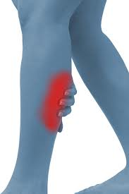
Peripheral circulation
Due to its blood
dilating features, ginkgo has
been used to treat poor
circulation – including intermittent claudication.
Notes:
Due to its ability to dilate blood vessels, ginkgo has been used to treat the symptoms of poor circulation. One of these is intermittent claudication – sporadic cramping or leg pain in the lower legs that can occur both at rest and/or during exercise.
The pain is due to clogged arteries, which make it more difficult for nourishing oxygen to reach the cells. Even though pain might be triggered by exercise, regular exercise is important because of its circulation-boosting effects.

Slide 11
Better circulation, better brain
Too much fat and too much
saturated and trans fats in
particular can clog arteries.
The oils in oily fish help to reduce
inflammation and boost blood circulation around the body and brain.
Notes:
Enjoying a healthy mixed diet is an important way to ensure that your circulation is healthy, too. Try to include around two to three servings of oily fish each week which contain essential omega-3 fats.
Research shows that omega-3 fatty acids reduce inflammation and may help lower the risk of chronic diseases such as heart disease, cancer, and arthritis.
Reducing inflammation helps blood to circulate more effectively around your body and your brain. BiOmega™ is another excellent source of the essential omega-3s docosahexaenoic acid (DHA), also a major component of the brain and eyes.

Slide 12
Cut the fat!
Ditch foods that contain saturated
and trans fats (fatty meat
and full fat dairy).
Choose healthier, unsaturated
fats (from fish, seeds, nuts, olive
and canola oils).
Notes:
To reduce internal inflammation, try to avoid eating too much fat in general and ditch foods that contain trans fats. Although trans fats are unsaturated, they behave like saturated fats in the body and can trigger similar health issues. Instead of saturated fats (from fatty meat and full fat dairy), choose healthier, unsaturated fats (from fish, seeds, nuts, olive and canola oils).

Slide 13
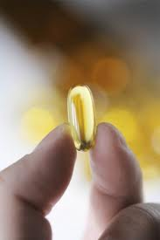
More omega-3s
Choose less fat and healthier omega-3
fats to reduce inflammation and aid circulation.
BiOmega™ is an excellent source of
the essential omega-3
docosahexaenoic acid (DHA), an
important component of the brain
and eyes.
Notes:
To reduce internal inflammation, try to avoid eating too much fat in general and ditch foods that contain trans fats. Although trans fats are unsaturated, they behave like saturated fats in the body and can trigger similar health issues. Instead of saturated fats (from fatty meat and full fat dairy), choose healthier, unsaturated fats (from fish, seeds, nuts, olive and canola oils).
Reducing inflammation helps blood to circulate more effectively around your body and your brain. BiOmega™ is another excellent source of the essential omega-3s docosahexaenoic acid (DHA), also a major component of the brain and eyes.

Slide 14
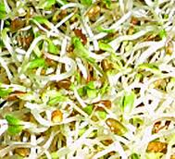
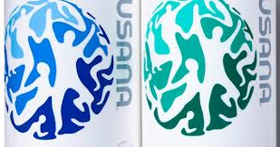
More brain essentials
B-group vitamins + antioxidant
vitamins C and vitamin E are
also important for maintaining
brain function.
Find them all in your daily
Essentials™.
Notes:
B-group vitamins as well as antioxidant vitamins C and vitamin E are also important for maintaining brain function. These potent antioxidants may help to prevent against oxidative stress that is associated with age-related cognitive decline. Find all of these in your daily Essentials™.

Slide 15
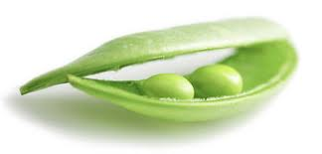
Ginkgo + PS = a dream team
Gingko PS contains
gingko plus a
special type of fat –
Phosphatidylserine (PS).
Ginkgo has powerful anti-inflammatory antioxidant action and PS can enter where ginkgo can’t.
Notes:
PS contains both amino acids and fatty acids and is a component of all cell membranes.

Slide 16
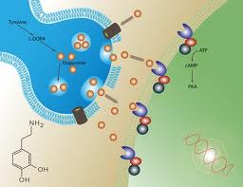
USANA’s Ginkgo-PS™
‘Administration of GBE complexed
with phosphatidylserine resulted
both in improved secondary
memory performance and
significantly increased speed of
memory task performance across all of the post-dose testing sessions.’
Notes:
Hum Psychopharmacol. 2007 Jun;22(4):199-210.
Acute cognitive effects of standardised Ginkgo biloba extract complexed with phosphatidylserine.
http://www.ncbi.nlm.nih.gov/pubmed/17457961

Slide 17
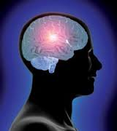
PS may improve cognition
PS may enhance mental ability
and help improve cognition.
PS is needed for brain cells to metabolise glucose and bind with neurotransmitters – an essential
process for learning, memory and other brain functions.
Notes:
Brain cells contain the highest concentration of PS in the body. This special type of lipid (fat) enables brain cells to metabolise (use) glucose and is also needed to release and bind with neurotransmitters – all of which play an important part in learning, memory and other cognitive (brain) functions. For this reason, PS may help to improve cognitive function including enhancing mental ability. Take with BiOmega™ as PS works with the omega-3 essential fat, DHA.
Altern Med Rev. 2007 Sep;12(3):207-27.
Omega-3 DHA and EPA for cognition, behavior, and mood: clinical findings and structural-functional synergies with cell membrane phospholipids.
Kidd PM. Source University of California, Berkeley, California, USA.

Slide 18
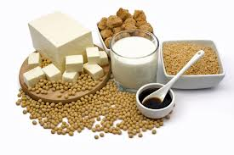
According to the FDA…
‘Consumption of
phosphatidylserine may
reduce the risk of
dementia in the elderly.’
US Health Department of Health and Human Services.
Notes:
The United States Food and Drug Administration has allowed PS two qualified health claims (which aren’t easy to obtain!). These are: ‘Consumption of phosphatidylserine may reduce the risk of dementia in the elderly’ and ‘Consumption of phosphatidylserine may reduce the risk of cognitive dysfunction in the elderly.’
US Health Department of Health and Human Services. US Food and Drug Administration. 10903 New Hampshire Avenue, Silver Spring, MD 20993. http://www.fda.gov/Food/LabelingNutrition/LabelClaims/QualifiedHealthClaims/ucm072999.htm

Slide 19
Teaching an old dog new tricks?
Scientists tested whether
supplements could protect
nerve tissue in elderly beagles
(ginkgo biloba and
phosphatidylserine plus vitamin E and pyridoxine).
Positive, long lasting results were seen.
Notes:
The results of one study suggest that you can indeed teach an old dog new tricks! Scientists from the University of Toronto examined whether dietary supplements could protect nerve tissue in elderly beagles. Nine dogs were given supplements that contained phosphatidylserine, ginkgo biloba, plus vitamin E and pyridoxine (which you’ll find in the Essentials™ range)
To assess that it was the supplement that was causing the effects, the scientists used a crossover design for the experiment. So, one group received the supplement and the other was given a control substance in the first phase. Results were noted and the treatment conditions were then reversed for the second phase.
The researchers found that brain function was significantly improved in the supplemented dogs compared with the control dogs, and the effect was long lasting. The fact that both groups of dogs could be affected by the supplements suggests these results are especially convincing.
Can Vet J. 2008 Apr;49(4):379-85.
Improvement of short-term memory performance in aged beagles by a nutraceutical supplement containing phosphatidylserine, Ginkgo biloba, vitamin E, and pyridoxine.
Araujo JA, Landsberg GM, Milgram NW, Miolo A.
Source Department of Pharmacology, University of Toronto, 1 King's College Circle, Toronto, Ontario. josepha@cancog.com. http://www.ncbi.nlm.nih.gov/pubmed/18481547

Slide 20
USANA’s Ginkgo-PS™
Ginkgo-PS uses standardised
ginkgo biloba extract plus
phospholipid complex as soy
lecithin.
The combination of ginkgo and PS
appears to boost the brain effects associated with a low dose of ginkgo biloba extract.
Notes:
Combining ginkgo with PS is a dream team because while the ginkgo contains powerful anti-inflammatory antioxidants, PS has the ability to enter nerve cells and enter where ginkgo can’t go.

Slide 21
Directions
Take two tablets twice daily with food.
Speak with your health care professional about any complementary medicines you use. May have an additive anticoagulant effect when taken with aspirin, warfarin or other blood-thinning drugs or supplements so consult your doctor if you’re already taking a prescribed anticoagulant or aspirin.
USE ONLY AS DIRECTED. ALWAYS READ THE LABEL.
Ginkgo-PS is laboratory tested, quality guaranteed. Meets British Pharmacopoeia (BP) specifications for potency, uniformity and disintegration where applicable

Slide 22
It might not make you Einstein…
But it’s worth a try!

