Slide 2
Fuel your cellular engines!
Coenzyme Q10 (CoQ10 or ubiquinone) is a
fat-soluble antioxidant.
It is ubiquitous – found almost everywhere in the human body.

Slide 3
Energy producer
CoQ10 produces 95 per cent of your cell’s energy.
Found in highest concentrations in the inner membrane of the mitochondria.

Slide 4
High energy needs
Getting enough CoQ10 is especially important to power these high energy cells.

Slide 5
Mitochondria EXPLAINED
Tissues and organs that need a lot of energy have large numbers of mitochondria e.g. heart, liver and muscle cells.

Slide 6
Heart smart
Human studies show CoQ10’s can help to maintain heart health.

Slide 7
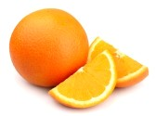
Made by the body for the body
CoQ10 is made in the liver from the amino acid, tyrosine.
Vitamin C and B vitamins including folic acid are also needed to make CoQ10.

Slide 8
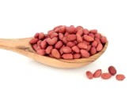
Find it in foods
CoQ10 is found in foods such as liver, kidney, whole grains, oily fish including tuna, peanuts, walnuts, chicken, canola and soybean oil.
Notes:
Average diet provides around 10mg.

Slide 9
How it works
Cells get the energy or fuel they need via a complex set of processes. These happen in the mitochondria, parts of the cells where energy is stored.

Slide 10
Made in mitochondria
The energy is stored as adenosine-5-triphosphate or ATP. Every cell in your body uses ATP.
Coenzyme Q10 (CoQ10) is needed by the mitochondria to make ATP.

Slide 11
So how does CoQ10 work?
When ATP breaks down, the energy created is used by cells for processes such as active transport, DNA replication and muscle contraction.

Slide 12
What about deficiency?
Deficiency of CoQ10 is seen in some medical conditions – but whether deficiency is a cause of the disease or a side effect of it, is still being researched.

Slide 13
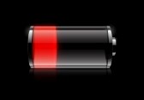
Correcting deficiency
A CoQ10 supplement can correct deficiency – whether due to illness or age. It helps to feed exhausted cells that are starved of energy.
Notes:
More studies are continuing to examine the effects of CoQ10 on survival after a major condition.

Slide 14
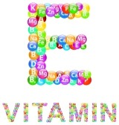
Antioxidant action
As an antioxidant, it rivals vitamins E and C. In addition, CoQ10 helps to regenerate and recycle vitamin E. CoQ10 is the only lipid-soluble antioxidant that is made in your body.

Slide 15
Running out of fuel?
Without CoQ10, the cells gradually lose power. Over time, continued low levels of cellular energy can have a negative health impact – a bit like a car running out of fuel.

Slide 16
Powering our athletes
In athletes, CoQ10 may:
reduce muscle fatigue
speed up recovery times
improve athletic performance.
Studies show greater improvement in both anaerobic and aerobic exercise with CoQ10 supplementation.
Notes:
Those who need a boost to heart health. The heart uses a lot of energy and it is thought that CoQ10 might benefit muscles which have a high energy turnover. Large studies have shown that supplementing with CoQ10 can improve heart health and quality of life without side effects.
Certain medications which block the production of cholesterol in the liver interfere with the production of CoQ10 which helps to promote healthy muscle function, boosting the body’s immune system and offering relief from migraines.
People over 65 years. Our ability to produce CoQ10 decreases with age.
Levy HB, Kohlhaas HK. Considerations for supplementing with coenzyme Q10 during statin therapy. Ann Pharmacother. 2006 Feb;40(2):290-4. Epub 2006 Jan 31. Accessed 1 August 2013. Available from: http://www.ncbi.nlm.nih.gov/pubmed/16449543?dopt=Abstract

Slide 17
Could your engines do with a boost?
General health
Heart health
Certain medicines
People over 65
Notes:
Those who need a boost to heart health. The heart uses a lot of energy and it is thought that CoQ10 might benefit muscles which have a high energy turnover. Large studies have shown that supplementing with CoQ10 can improve heart health and quality of life without side effects.
Certain medications which block the production of cholesterol in the liver interfere with the production of CoQ10 which helps to promote healthy muscle function, boosting the body’s immune system and offering relief from migraines.
People over 65 years. Our ability to produce CoQ10 decreases with age.
Levy HB, Kohlhaas HK. Considerations for supplementing with coenzyme Q10 during statin therapy. Ann Pharmacother. 2006 Feb;40(2):290-4. Epub 2006 Jan 31. Accessed 1 August 2013. Available from: http://www.ncbi.nlm.nih.gov/pubmed/16449543?dopt=Abstract

Slide 18
According to Action for ME…
The adult daily supplement for CoQ10 is 30-200mg. The not-for-profit organisation Action for ME (Myalgic Encephalomyelitis) UK says higher doses may be recommended for medical conditions, including chronic fatigue syndrome and ME.
Notes:
Coenzyme Q10. University of Maryland Medical Center. Accessed 1 August 2013. Available from: http://umm.edu/health/medical/altmed/supplement/coenzyme-q10

Slide 19
Heart Failure 2013 Congress…
Professor Svend Aage
Mortensen: ‘CoQ10 is
The first medication to
improve survival in chronic heart failure since ACE inhibitors and beta blockers more than a decade ago and should be added to standard heart failure therapy.’
Notes:
Coenzyme Q10 decreases all-cause mortality by half in randomised double blind trial 25 May 2013. Accessed 1 August 2013. Available from: http://www.escardio.org/about/press/press-releases/pr-13/Pages/first-drug-in-decade-improves-heart-failure-European Society of Cardiology. A potential new approach to improve heart failure outcome
mortality.aspx

Slide 20
Are you getting enough?
For healthy CoQ10 levels, take one CoQuinone 30™ capsule twice daily or just one CoQuinone 100™ – you’ll find similar amounts in a kilo of beef, half a kilo of sardines or a kilo of peanuts.

Slide 21
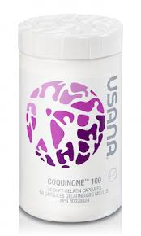
USANA’s CoQuinone
USANA’s CoQuinone 100™ or CoQuinone 30™ are a great way to ensure you keep your levels topped up.
If you take certain medicines please talk to your doctor.

Slide 22
Start your engines!
USANA‘s CoQuinone 30 contains 30mg of CoQ10 and 12.5mg of alpha lipoic acid per soft gel capsule. Triple strength CoQuinone 100 contains 100mg of CoQ10 and 40mg alpha lipoic acid per capsule.

Slide 23
Contains Alpha lipoic acid
Alpha lipoic acid is a powerful antioxidant that’s both fat- and water-soluble.
It attacks waste products and helps recycle other antioxidants for extra cell protection.

Slide 24
better bioavailability
Nutrients are mixed with medium chain triglycerides, glycerin, and lecithin to boost absorption for unbeatable bioavailability.

Slide 25
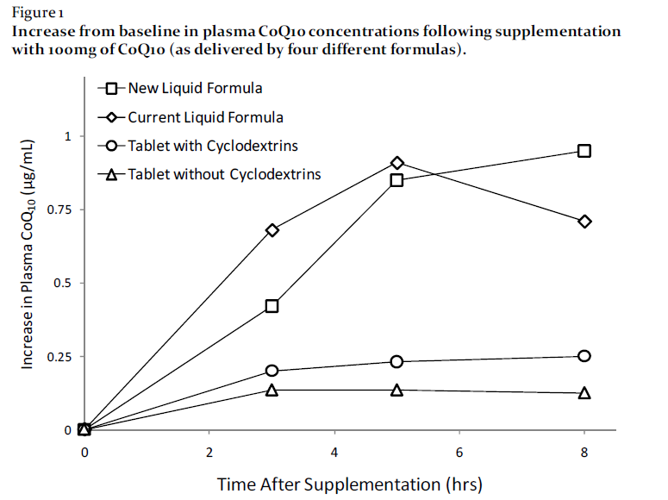
better bioavailability
The better performance
of USANA CoQ10 is
measured by higher
plasma concentrations
measured at two, four,
six and eight hours.
www.usana.com/media/File/dotCom/company/science/crb/USANA_CRB_CoQ10Bioavailability.pdf
Notes:
http://www.usana.com/media/File/dotCom/company/science/crb/USANA_CRB_CoQ10Bioavailability.pdf

Slide 26
Testing the best!
March 2013, USANA: CoQuinone 30™ was evaluated BY Consumerlab.com and passed testing for label claims for the fourth time in a row.
Clinical tests in USANA’s laboratories show that USANA CoQuinone delivers CoQ10 in much higher quantities than solid formulations or from competitive liquid formulations.
Notes:
In March 2013, USANA Health Sciences Inc. was evaluated and approved by ConsumerLab.com LLC, a leading provider of independent product test results. Their results showed that for the fourth time in a row, USANA's CoQuinone 30™ passed testing for label claims. Clinical tests performed in USANA’s laboratories show that USANA CoQuinone delivers CoQ10 in much higher quantities than solid formulations or from competitive liquid formulations, making USANA CoQuinone more bioavailable than other CoQ10 products. (Cuomo J, Rabovsky A. Comparative Bioavailability of Coenzyme Q10 in Four Formulations.
2000. USANA Clinical Research Bulletin, USANA Health Sciences, Inc. SLC, UT).

Slide 27
Daily dosage
Take one or two CoQuinone 30 capsules daily, preferably with meals or take one CoQuinone 100 capsule daily, preferably with meals. Eating with meals further boosts bioavailability.

Slide 28
Please remember!
Do not take while on warfarin therapy without medical advice.
Vitamin supplements should not replace a balanced diet.
USE ONLY AS DIRECTED. ALWAYS READ THE LABEL.
IF SYMPTOMS PERSIST SEE YOUR HEALTH CARE PRACTITIONER.

Slide 29
Thanks for listening!
©USANA Australia New Zealand
Please do not amend this
Presentation without permission from
USANA Health Sciences,
3 Hudson Avenue Castle Hill 2154, New South Wales, AU
For more information, contact ravinder.lilly@au.usana.com

