Slide 2
The Essentials for good health!
Focus on regular exercise
plus a healthy diet
for good health.
Notes:
recent dietary guidelines released by the National Health and Medical Research Council (NHMRC) focus on regular exercise as well as a healthy diet as being a side-by-side essentials for good health. It’s a powerful combo for body and mind health.

Slide 3
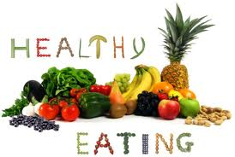
what makes it healthy?
All five food groups
Breads and cereals
Vegetables
Fruits
Dairy or calcium-enriched soya
Meat and meat alternatives
Notes:
A wide variety of foods from all of the food groups is the cornerstone to healthy eating. These groups are:
Breads and cereals: Including rice, pasta, couscous, noodles and quinoa. Choose wholegrain varieties when you can to provide slow release energy (low GI), fibre, B vitamins, iron and more. Aim for up to six serves per day.
Vegetables: All types are great choices including fresh, frozen vegetables, legumes (such as baked beans, lentils and chick peas). They’re low in calories and high in nutrients, phytochemicals, antioxidants, fibre, vitamins A and C, folate, fibre and water. Aim for five or more serves per day.
Fruit: rich in water-soluble vitamins like vitamin C and folate, fruits also supply slow-release carbohydrates, energy and fibre so satisfy your sweet tooth the natural way! Aim for two serves daily.
Dairy or calcium-enriched soya: Go for low-fat dairy products and/or calcium-enriched soya products to provide calcium, protein and more. Aim for three or more serves per day.
Meat and meat alternatives: This includes meat, poultry, fish, seafood, eggs, legumes, nuts and pulses. Aim for two to three serves daily.

Slide 4
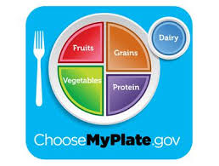
IS YOUR DIET PERFECTION ON A PLATE?
Most of us don’t eat the perfect
diet – at least not all of the time.
USANA’s nutritional supplements
Are formulated to fill nutritional
gaps and ensure that nutrient
wise, you don’t fall short.

Slide 5
Award-winning Essentials™
Ground-breaking range of vitamins, minerals and phytonutrients/antioxidants.
Taking Essentials regularly can help to prevent deficiencies by providing the vital vitamins and minerals needed to boost good health.
So who needs ‘em?.
Notes:
USANA founder, Dr Myron Wentz, developed the ground-breaking range of vitamins believing that if a wide mix of nutrients – vitamins, minerals and phytonutrients/antioxidants – could boost health at the cell level, that it could also boost the health of the whole body. The result was the award winning Essentials™ range. Taking Essentials regularly can help to prevent deficiencies by providing the vital vitamins and minerals needed to boost good health. They may not affect how you feel day-to-day, but they top up any low levels which is important for long-term good health.

Slide 6
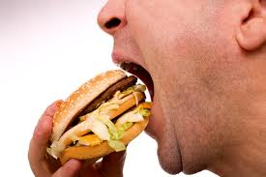
Junk food junkies
Many fast foods are high
on fat, salt and sugar and
low on fibre and nutrients.
So, your body uses up
nutrient stores just
to process the nutrient-depleted eats in fast foods.

Slide 7
Athletes
Athletes may have increased
needs for nutrients.
Vigorous training raises the
production of free radicals raising
the need for antioxidants.
Essentials contains components that
helps your body absorb more iron
from foods so take them with meals.
Notes:
Exercise-conscious athletes may have increased needs for nutrients – that’s because vigorous training increases the production of free radicals which in turn may raise the body’s need for antioxidant vitamins (beta-carotene, bioflavonoids, vitamin C and vitamin E). To maintain strong, healthy bones and joints, getting enough calcium and iron are a must. Essentials contains components that can help your body absorb more iron from foods (although it does not contain it) so try to take them with meals.

Slide 8
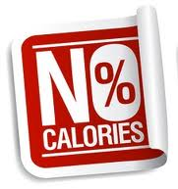
People on restrictive diets
This includes long-term
weight-losers, meal-skippers,
stressed out irregular eaters
and those with food
intolerances.

Slide 9
People with chronic conditions
Digestive disorders that
affect the intestines
(where foods are
absorbed into the body).

Slide 10
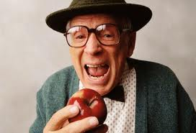
Older people
Need less food with age.
Your body also gets less
efficient at absorbing and
using the nutrients you do
consume e.g. vitamin B12.
The need for high quality nutrition remains as important as ever.
Notes:
Simply getting older can affect your vitamin and mineral intake and how your body uses nutrients. You tend to need less food with age. Your body also gets less efficient at absorbing and using the nutrients you do consume. So, vitamin B12, for example, which is quite a big nutrient for the body to absorb, gets more difficult to absorb with age. Yet, the need for high quality with age nutrition remains as important as ever.

Slide 11
Vitamin D
Around one in three of us
in Australia and New
Zealand fall short of the
sunshine vitamin.
Limited exposure to sunlight. dark-skinned people, those who keep skin covered, fair skinned people, people who are very overweight or obese.
Notes:
Studies show that surprisingly, many of us in Australia and New Zealand fall short of the so called sunshine vitamin, vitamin D. This has a wide range of functions including bolstering immune health and maintaining healthy, strong bones and teeth, lowering the risk of chronic diseases.
If you have limited exposure to sunlight, if you’re dark-skinned and/or if you cover your skin for cultural reasons, you could be at risk of low vitamin D levels. Fair skinned people may also be D-deficient (as they may avoid the sun due to fear of sunburn). People who are very overweight or obese may also need a supplement as despite the fact that the vitamin D is produced by the body, it gets stuck in layers of fat and it can’t be used by the body.

Slide 12
Pregnancy Essentials
Thinking about pregnancy? Not all
pregnancies are planned.
The National Health and Medical
Research Council (NHMRC)
recommends a number of key
nutrients for pregnant and breastfeeding women. Some should be taken pre-pregnancy.
Notes:
Whilst many pregnancies are planned, around 200,000 pregnancies in Australia are not planned according to the Better Health Channel statistics.
Until quite recently, the focus on folic acid was the only real focus as a nutritional supplement during pregnancy. But now, the National Health and Medical Research Council (NHMRC) recommends a number of nutrients for pregnant and breastfeeding women. Based on the latest available evidence, the key nutrients for pregnant women are:

Slide 13
Folic acid
Eat a variety of folate-containing
fruits and vegetables.
Getting enough folate/folic acid helps
to reduce the risk of neural tube
defects (NTDs).
The government strongly advises
that women take a folic acid supplement for three months before conception if possible and for the first three months of pregnancy.
Notes:
Getting enough folate/folic acid in pregnancy is vital because it helps to reduce the risk of neural tube defects. This is where the spinal cord does not close properly and can cause varying degrees of disability in the unborn baby.
Bread (apart from organic kinds) is now fortified with folic and a slice of bread provides around 40 micrograms of folic acid. Other food sources of folate include leafy green vegetables (steam lightly or stir-fry to retain the delicate B vitamin), leeks, oranges, wholegrains wheat germ, starchy vegetables like parsnips and potato, Vegemite and Marmite. Unsalted nuts also provide folate – but not the roasted kind as folate is lost during the cooking process.
As well as eating a variety of folate-containing fruits and vegetables, the government strongly advises that women take a folic acid supplement (folate and folic acid are the same vitamin but it’s called folic acid when in supplement form). It is best to take this for three months before conception if possible and for the first three months of pregnancy.
Supplemental information
All pregnant women should take a supplement that contains folic acid.
Food Standards Australia New Zealand (FSANZ) suggests: ‘Look for supplements that contain at least 400 micrograms of folic acid’.
Essentials provides 500mcg folic acid per daily dose making it a good choice during pregnancy.
Women carrying more than one baby, those who are taking certain anticonvulsants, women with diabetes and those who have a tendency towards blood clotting or a family history of neural tube defects need to take a much higher dose of folic acid – talk with your doctor for individual advice.

Slide 14
FOLIC ACID: SUPPLEMENT FACTS
‘Look for supplements that contain
at least 400 micrograms of folic
acid’. (FSANZ)
Essentials provides 500mcg folic
acid per daily dose making it a
good choice during pregnancy.
Women carrying more than one baby, those who are taking certain anticonvulsants, women with diabetes and those who have a tendency towards blood clotting or a family history of NTDs need to
take a much higher dose of folic acid – talk with your doctor for individual advice.
Notes:
Supplemental information
All pregnant women should take a supplement that contains folic acid.
Food Standards Australia New Zealand (FSANZ) suggests: ‘Look for supplements that contain at least 400 micrograms of folic acid’.
Essentials provides 500mcg folic acid per daily dose making it a good choice during pregnancy.
Women carrying more than one baby, those who are taking certain anticonvulsants, women with diabetes and those who have a tendency towards blood clotting or a family history of neural tube defects need to take a much higher dose of folic acid – talk with your doctor for individual advice.

Slide 15
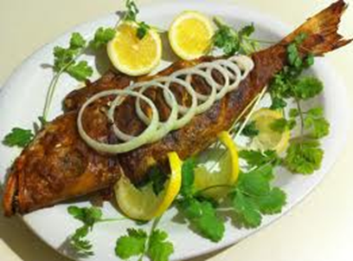
Iodine
Mild-to-moderate iodine
deficiency has been seen in
Australia and New
Zealand since the early 2000s.
FSANZ: ‘Iodine is found in many
foods, but much of the Australian and New
Zealand food supply is now low in iodine, which has led to widespread iodine deficiency.’
Notes:
After milk-producers switched from using iodine-based to chlorine-based cleaners to clean dairy equipment, and more people ditched iodised table salt for gourmet salt – or much less in general – iodine deficiency became an issue in Australia and New Zealand. Mild-to-moderate iodine deficiency has been seen in Australia and New Zealand since the early 2000s.
According to FSANZ, ‘Iodine is in many foods, but much of the Australian and New Zealand food supply is now low in iodine, which has led to widespread iodine deficiency.’ Also: ‘The actual iodine content of food will vary depending on where it is grown and how it is made.’
Now that bread manufacturers use iodised salt to make bread (except organic bread), many of us get more iodine, but not enough to meet the needs of pregnant and breastfeeding women. Lack of iodine can lead to learning difficulties in the baby. Seafood is a good source of iodine as is seaweed and sushi but sushi is not recommended in pregnancy because it contains raw fish which should be avoided during pregnancy to prevent the small risk illness/mercury build up.
Supplemental information
All women should take a supplement that contains iodine.
During pregnancy, the NHMRC and the New Zealand Ministry of Health recommend that women take 220μg of iodine per day. Women who are breastfeeding should have 270μg per day.
Essentials contains 300mcg iodine per four tablet daily dose so it’s suitable for pregnancy and breastfeeding.
Food Standards Australia New Zealand. Iodine in food last reviewed September 2012. Accessed 22 March 2013. Available from: http://www.foodstandards.gov.au/scienceandeducation/factsheets/factsheets/iodinefortification/iodineinfood.cfm
NHMRC Public Statement. Iodine supplementation for pregnant and breastfeeding women. Accessed 22 March 2013. Available from: http://www.nhmrc.gov.au/_files_nhmrc/publications/attachments/new45_statement.pdf

Slide 16
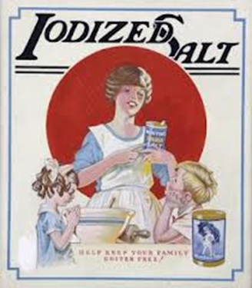
IODINE: SUPPLEMENT FACTS
Take a supplement that contains
iodine during pregnancy.
The NHMRC and the New Zealand
M of H recommend that pregnant
women take 220μg of iodine per day.
Women who are breastfeeding should
have 270μg per day.
Essentials contains 300mcg iodine daily dose so it’s suitable for pregnancy and breastfeeding.
Notes:
Supplemental information
All women should take a supplement that contains iodine.
During pregnancy, the NHMRC and the New Zealand Ministry of Health recommend that women take 220μg of iodine per day. Women who are breastfeeding should have 270μg per day.
Essentials contains 300mcg iodine per four tablet daily dose so it’s suitable for pregnancy and breastfeeding.
Food Standards Australia New Zealand. Iodine in food last reviewed September 2012. Accessed 22 March 2013. Available from: http://www.foodstandards.gov.au/scienceandeducation/factsheets/factsheets/iodinefortification/iodineinfood.cfm
NHMRC Public Statement. Iodine supplementation for pregnant and breastfeeding women. Accessed 22 March 2013. Available from: http://www.nhmrc.gov.au/_files_nhmrc/publications/attachments/new45_statement.pdf

Slide 17
Vitamin D
Deakin University says
nearly three quarters
(73 per cent) of people have
vitamin D levels
considered to be below the
optimal for musculoskeletal health.
For pregnant and breastfeeding women and for adults up to the age of 70, a daily dose of 15μg (or 600 IU) of dietary vitamin D is recommended.
Notes:
Scientists are continuing to find more and more problems relating to inadequate vitamin D and have set the safe upper limit as being 100mcg (4000 IU).

Slide 18
Vitamin D: SUPPLEMENT FACTS
Most pregnancy supplements
provide less than the
recommended adequate intake
of 15 mcg (600 IU). If you’re at
increased risk of deficiency,
consult your doctor for advice.
Essentials contains 20μg (800 IU) per daily dose of four tablets.
Notes:
Vitamin D deficiency strikes one-third of AustralianDeakin University一 16 January2012. Accessed 22 March 2013. Available from: http://www.deakin.edu.au/news/2012/160112vitaminddeficiency.php
Office of Dietary Supplements. National Institutes of Health. Dietary Supplement Fact Sheet: Vitamin D. Last reviewed 24 June 2011. Accessed 22 March 2013. Available from: http://ods.od.nih.gov/factsheets/VitaminD-QuickFacts/

Slide 19
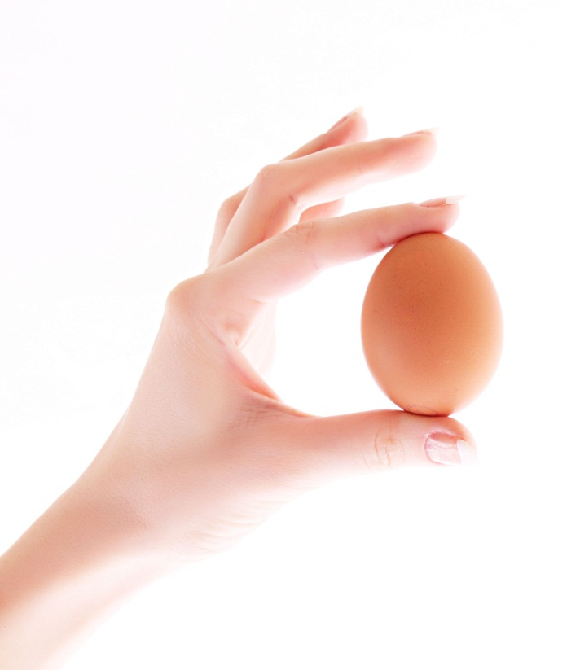
Vitamin B12
Needed for the development of the
nerves and for healthy blood.
Found mostly in animal products
(such as meat, eggs and dairy).
Algae is a vegan source but vegan mums-to-be may need a supplement of vitamin B12 daily.
,

Slide 20
VITAMIN B12: SUPPLEMENT FACTS
Essentials contains 200μg
of B12 per daily dose.
Unlike some B12-containing
nutrition supplements,
Essentials is suitable for vegetarians.
Notes:
Vegemite does not contain vitamin B12 but Marmite does.

Slide 21
But it takes two …
Poor motility signals DNA
Damage to the sperm and can
be caused by free radials.
Dr Anne Clarke: ‘If more than 20 per cent of sperm have evidence of DNA damage, the couple's chances of getting pregnant is significantly reduced and the risk of miscarriage is three to four times higher.’
Notes:
Dr Anne Clarke from Sydney’s Fertility First which aims to help couples with pregnancy: ‘If more than 20 per cent of the sperm have evidence of DNA damage, the couple's chances of getting pregnant is significantly reduced and the risk of miscarriage is three to four times higher,’
Although diet is not the only factor, it is an important one. So a healthy antioxidant rich diet is an essential for men, too

Slide 22
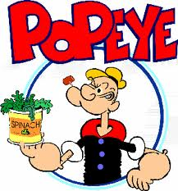
But it takes two …
Around one in eight men have an
enzyme that makes it difficult to
absorb folate from the diet. And,
folate deficiency together with low
levels of vitamin B6 and vitamin
B12 are linked with DNA damage
in sperm and that’s where a
supplement can help build up healthy levels.
Notes:
Stats from Dr Anne Clarke from Fertility First in Sydney.

Slide 23
Men: Supplement benefits
Dr Anne Clark from Sydney’s
Fertility First says that a high quality
multivitamin supplement will provide
enough folate and taking it for just two
months can often reverse sperm DNA
fragmentation. Talk to your doctor for
more information.

Slide 24
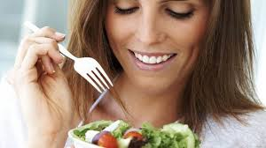
Calcium
Calcium: Your body becomes
more efficient at retaining
calcium as the baby relies
entirely on calcium from his
or her mother.
Women who don’t consume dairy products and/or have a vitamin D deficiency may need a supplement. Your doctor can tell you more.
Notes:
The major mineral that makes up the skeleton and bones is also needed for healthy nerve conduction and heart muscle function. Your body becomes more efficient at retaining calcium as the baby relies entirely on calcium from his or her mother.
Women who don’t consume dairy products and/or have a vitamin D deficiency may need a supplement. Your doctor can tell you more.

Slide 25
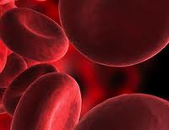
iron
The body becomes much more
efficient at absorbing iron during
pregnancy.
If stores are very low, you’re
multiple babies, if you are vegan or vegetarian or teenage mum-to-be, you may need extra iron.
Speak with your doctor about first. Iron supplements can be toxic in large amounts.
Notes:
The major mineral that makes up the skeleton and bones is also needed for healthy nerve conduction and heart muscle function. Your body becomes more efficient at retaining calcium as the baby relies entirely on calcium from his or her mother.
Women who don’t consume dairy products and/or have a vitamin D deficiency may need a supplement. Your doctor can tell you more.
Iron
During pregnancy, your body needs more iron for the increased blood vessel production for mother, developing baby and for the baby’s lifeline, the placenta. The baby also lays down a store of iron to last for the first six months or so of life (breast milk is naturally low in iron).
Your body becomes much more efficient at absorbing iron whilst iron losses are reduced during pregnancy as menstruation stops. If your stores are very low, you may need to get more from supplements for example if you are carrying more than one baby can run low on iron. Women who are vegan and vegetarian or teenage mums-to-be or women with multiple pregnancy may need iron supplementation. Speak with your doctor about whether you need iron supplements during pregnancy as iron can be toxic (poisonous) in large amounts.
Better Health Channel. Pregnancy and diet. Last updated 26 February 2013. Accessed 22 March 2013. Available from: http://www.betterhealth.vic.gov.au/bhcv2/bhcarticles.nsf/pages/Pregnancy_and_diet

Slide 26
For more information…
For more information on
Healthy eating in
pregnancy, log onto:
foodstandards.gov.au
Notes:
For more information on healthy eating in pregnancy, log onto: http://www.foodstandards.gov.au/consumerinformation/pregnancyandhealthyeating

Slide 27
USANA’s Essentials
Healthy eating and exercise plus
Down time helps boost your chances
of good health. USANA’s Essentials
provides optimal nutrition for
Everyone every day.
Have you had yours today?
Do not exceed the stated dose except on medical advice. Seek expert medical
advice if your child has a neural tube defect OR spina bifida/neural tube defects.
Vitamin supplements should not replace a balanced diet.
USE ONLY AS DIRECTED. ALWAYS READ THE LABEL.

